Slide 1

EasyReg
Checkpoint 2
Universidade de Aveiro - DETI - May 2025
1

Slide 2
Table of Contents
01
02
03
04
Backlog
Currently working on
Next Steps
Calendar
2

Slide 3
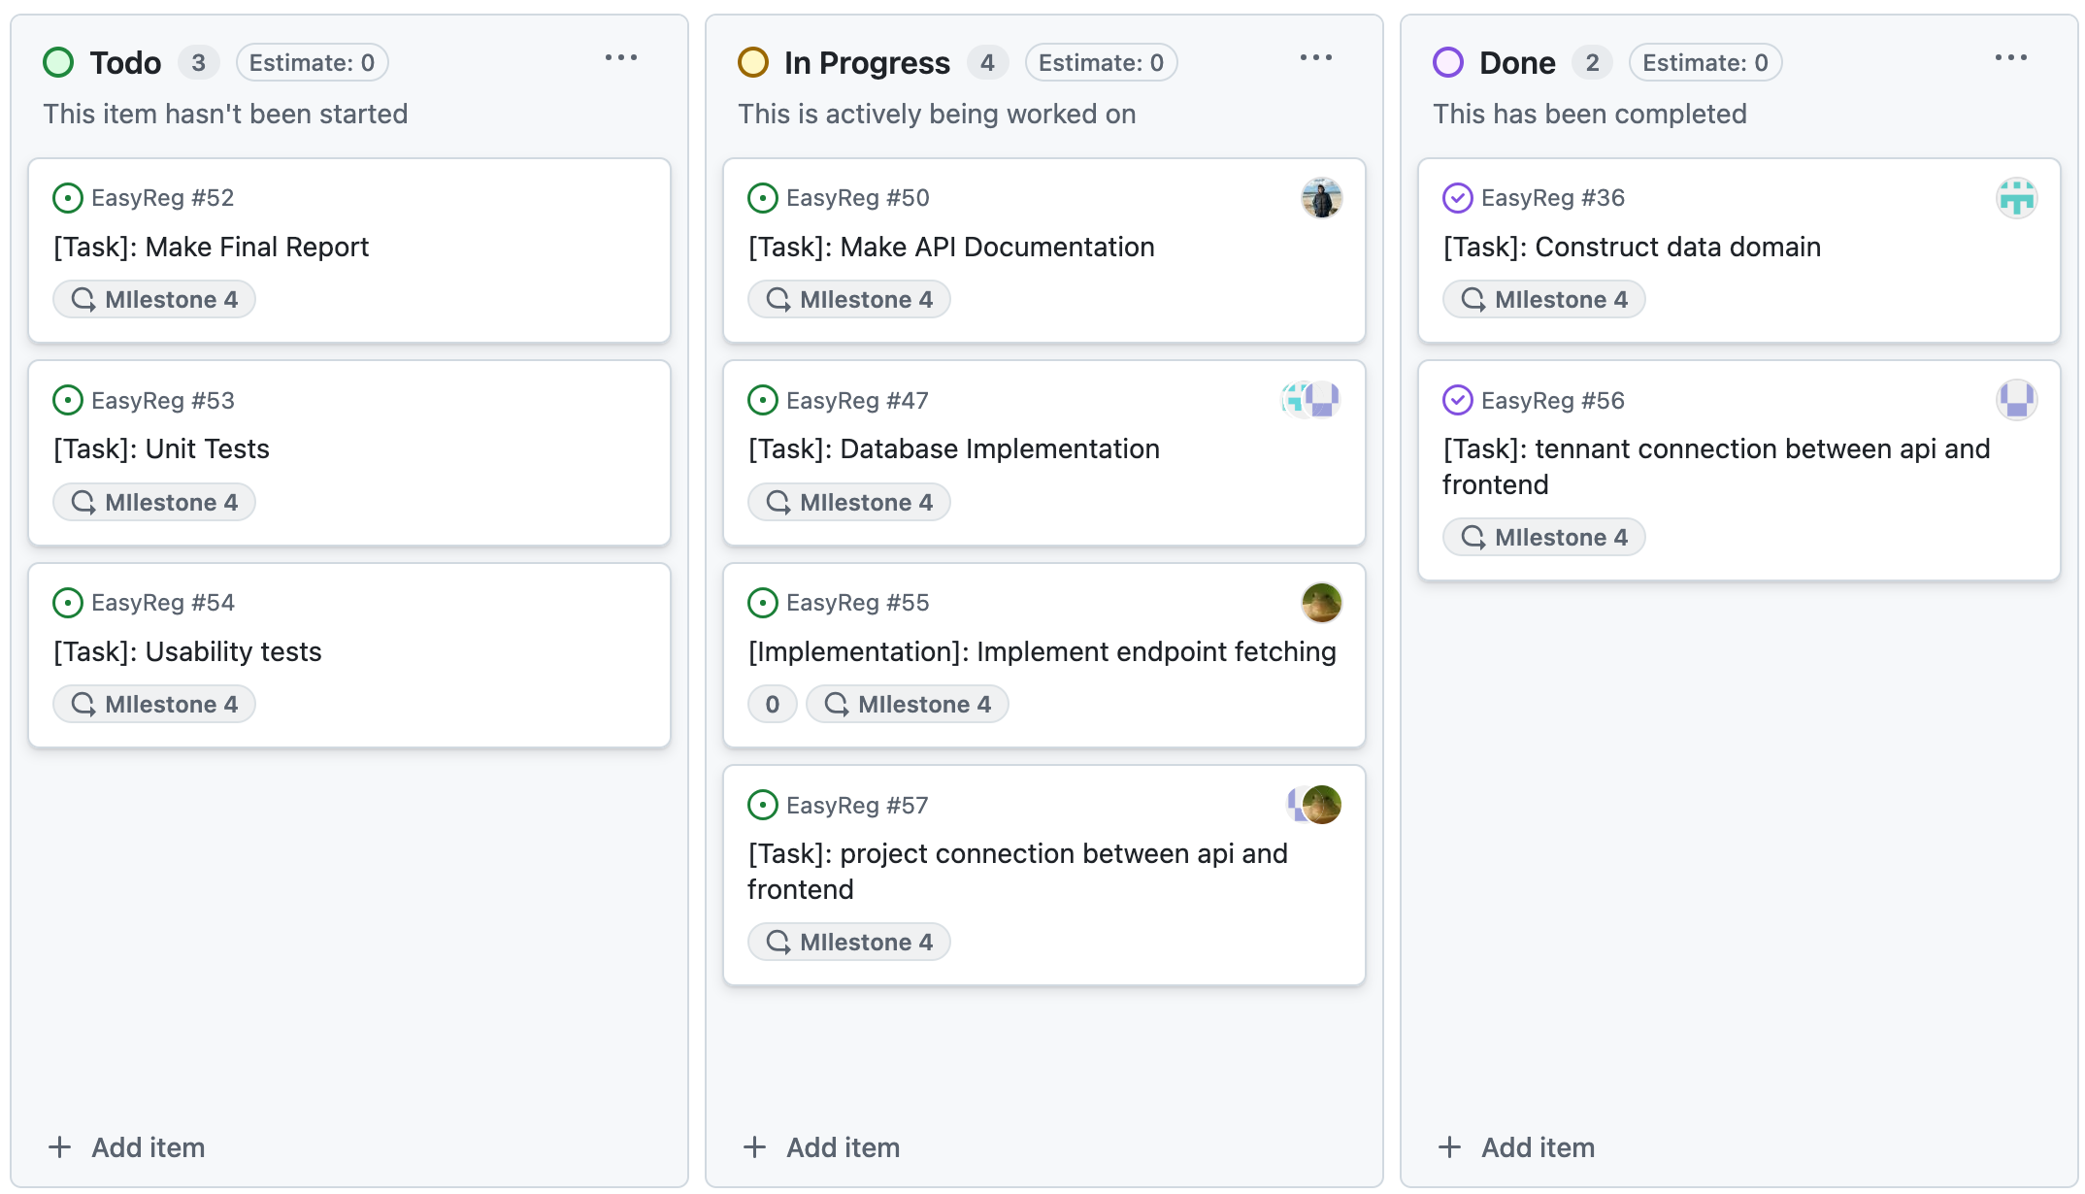
Backlog
3

Slide 4
Currently Working on (FrontEnd)
  Connections between API and FrontEnd
  CRUD methods for projects and tenants
  Internal logic with associating:
        Users -> Projects
        Projects -> Tenants
        Tenants -> Users
  Keycloak information fetching and authentication
4

Slide 5
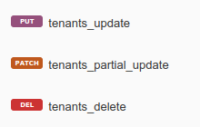

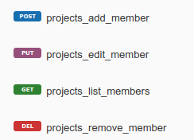

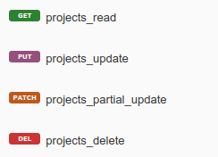
Currently Working on (BackEnd)
New tenant endpoints
Project endpoints
Project Members endpoints
5

Slide 6
Next Steps
  Project Dashboard and evidence pages
  Role Specific Screens
  Tests
      User Tests
      Usability Tests
      Feedback Analysis
  Reports and Documentation
  API Documentation
  Technical Report
6

Slide 7
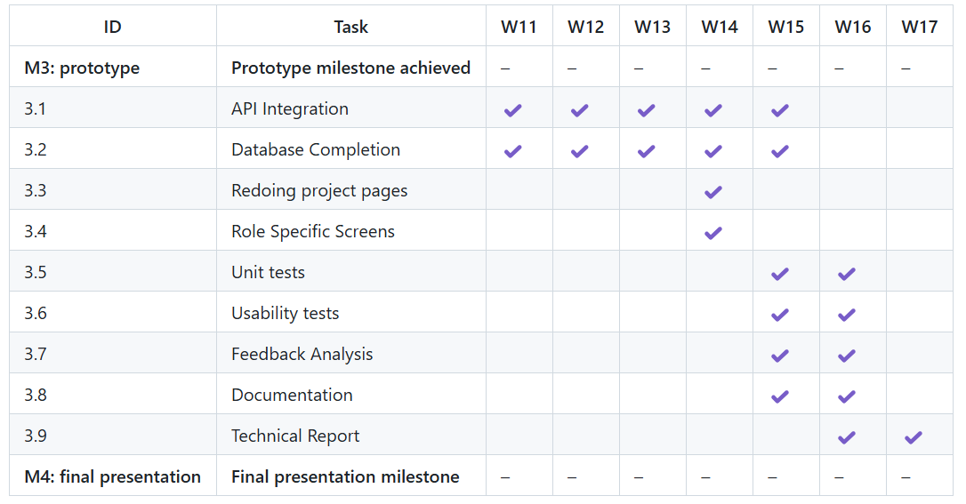
Calendar
7

Slide 8
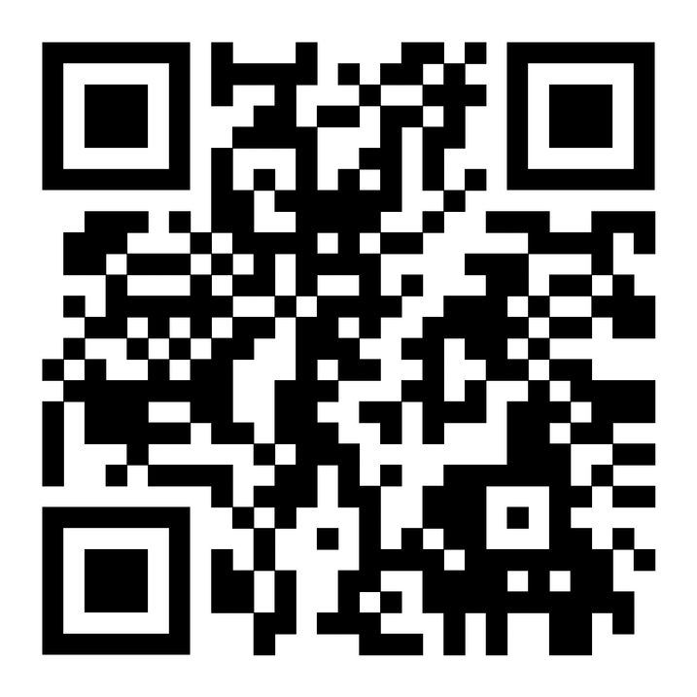
Micro-Site
Thank you!
8

